Slide 1
Linear Regression : A brief Introduction

Slide 2
Linear Regression
Linear regression is a machine learning algorithm which is based on the Supervised Learning.
Supervised learning is the type of machine learning in which machines are trained using well "labelled" training data, and on basis of that data, machines predict the output.
Linear Regression is an analysis that assesses whether one or more predictor variable explains the dependent variable.
Regression models a target prediction value(y) based on independent variables(x)
Regression is mostly used for finding out relationship between variables, forecasting and trends.

Slide 3
Linear Regression Contd.
Linear Regression has five basic key assumptions:
Linear relationship: There exists a linear relationship between the independent variable(x) and the dependent variable(y).
Homoscedasticity:Error terms must showcase constant variance.
No or little multicollinearity.
Residuals should follow a normal distribution.
No autocorrelations in error terms.

Slide 4
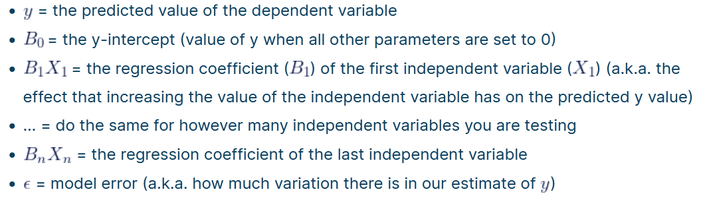
Types of Linear Regression
Simple Linear Regression:It is a type of Regression algorithms that models the relationship between a dependent variable and a single independent variable .The motive of the linear regression algorithm is to find the best values for m and c such that the errors are minimum in the equation y=mx+c , where m is slope and c is the intercept on y axis.
Multiple Linear Regression: It is a basically an extension of Simple linear regression, if more than one independent variable is used to predict the value of a numerical dependent variable.

Slide 5
Scatter Plot
Scatter plots are the graphs that present the relationship between two variables in a data-set. It represents data points on a two-dimensional plane or on a Cartesian system. The independent variable or attribute is plotted on the X-axis, while the dependent variable is plotted on the Y-axis. These plots are often called scatter graphs or scatter diagrams.
The data is displayed as a collection of points.
Positive Correlation: When the points in the graph are rising, moving from left to right, then the scatter plot shows a positive correlation. It means the values of one variable are increasing with respect to another.
Negative Correlation: When the points in the scatter graph fall while moving left to right, then it is called a negative correlation. It means the values of one variable are decreasing with respect to another.

Slide 6
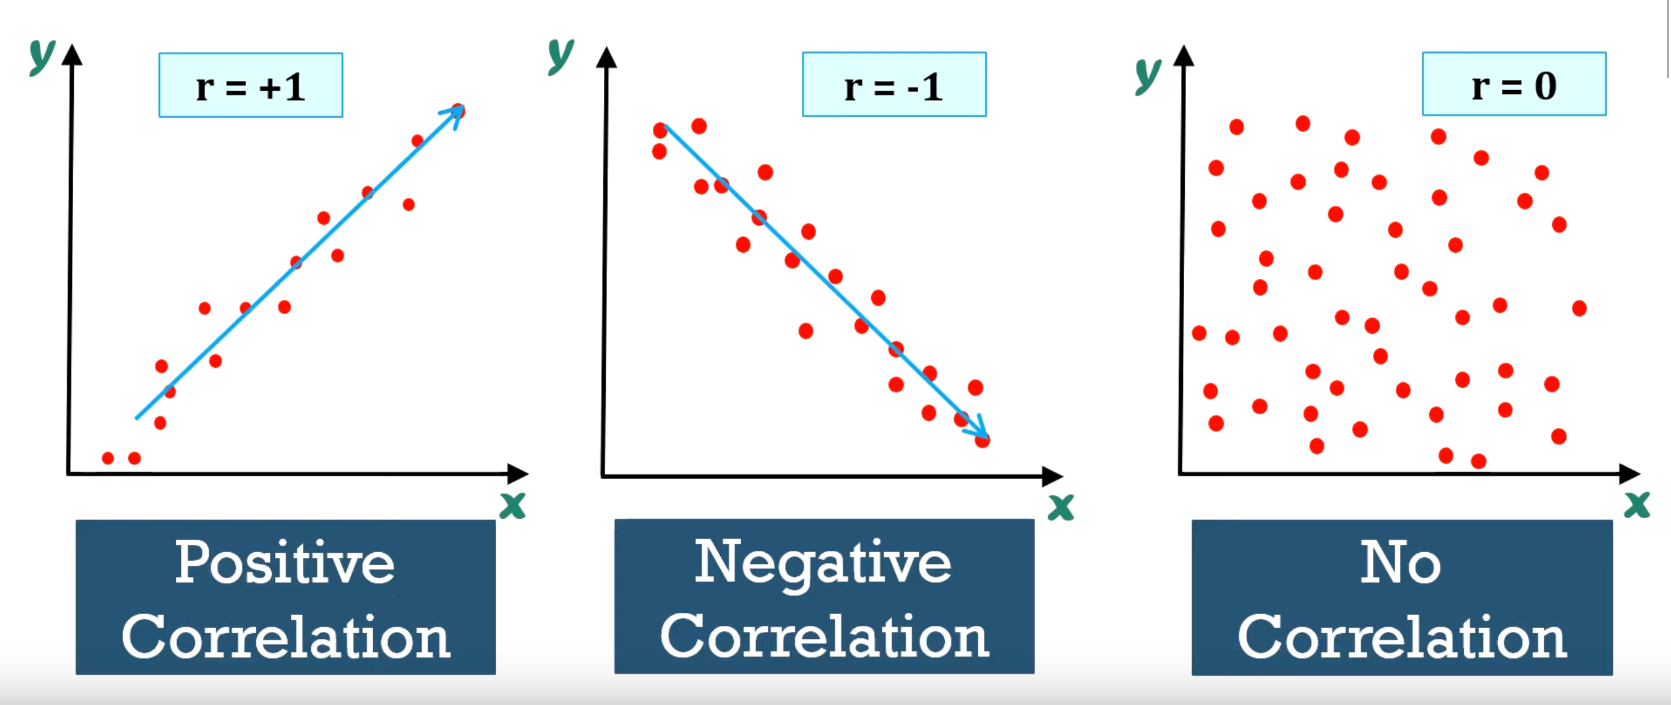
Scatter Plot Contd.
No Correlation When the points are scattered all over the graph and it is difficult to conclude whether the values are increasing or decreasing, then there is no correlation between the variables.

Slide 7
Mean Squared Error (Cost Function)
The Mean Squared Error measures how close a regression line is to a set of data points. It is a risk function corresponding to the expected value of the squared error loss.
Mean square error is calculated by taking the average, specifically the mean, of errors squared from data as it relates to a function.
A smaller MSE is preferred because it indicates that the data points are dispersed closely around its central moment (mean).
Lesser the MSE => Smaller is the error => Better the estimator.

Slide 8
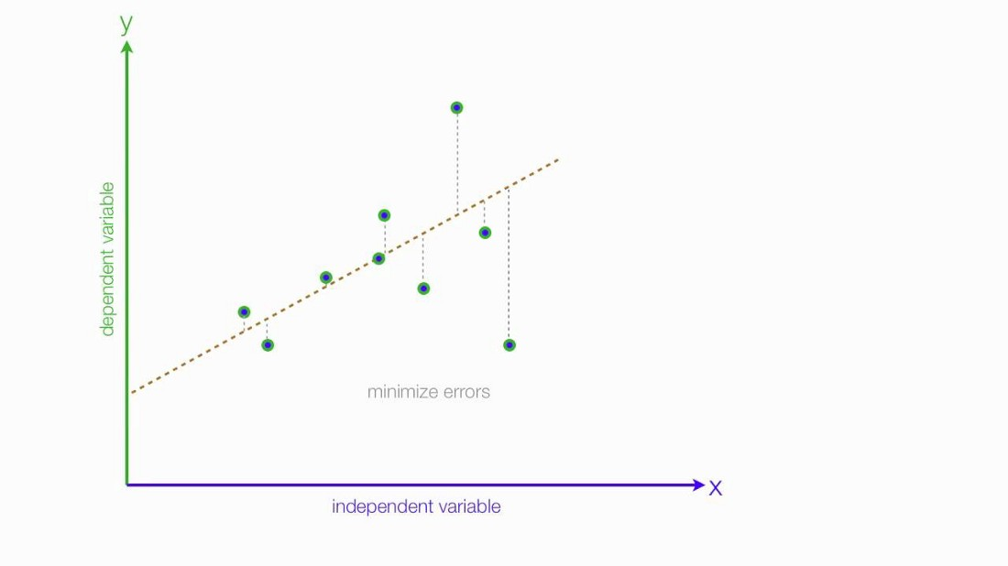
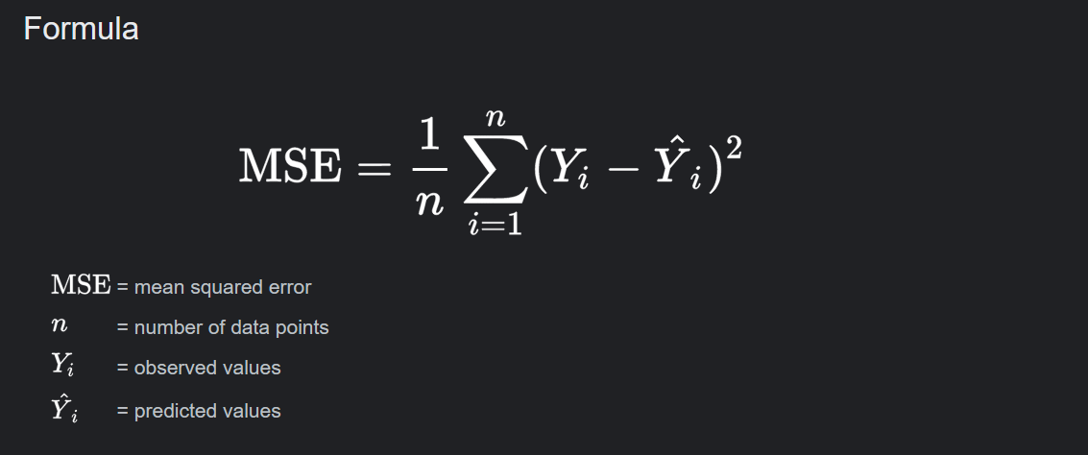
The Mean Squared Error is calculated as:

Slide 9
Disadvantages of Linear Regression
Linear regression is quite sensitive to outliers.
Linear Regression is Limited to Linear Relationships-By its nature, linear regression only looks at linear relationships between dependent and independent variables.
It is prone to multicollinearity between Independent Variables.

Slide 10
THANK YOU

